Slide 1
Mu Alpha Theta
First Meeting
04 October 2016
MAΘ
Notes:
※ was created on Google Slides and may contain discrepancies from the original presentation when converted to PowerPoint

Slide 2
Meet the Executive Board
President: Jung Oh Role: set agendas, lead and manage organization meetings
Vice Presidents: Steve Lee Role: perform the duties of the president in his/her absence, assist the president in duties
Secretary: Katie Beach Role: establish attendance roster, keep track of service hours
Treasurer: Jacob Bizzarri Role: Manage financial and service information within the club

Slide 3
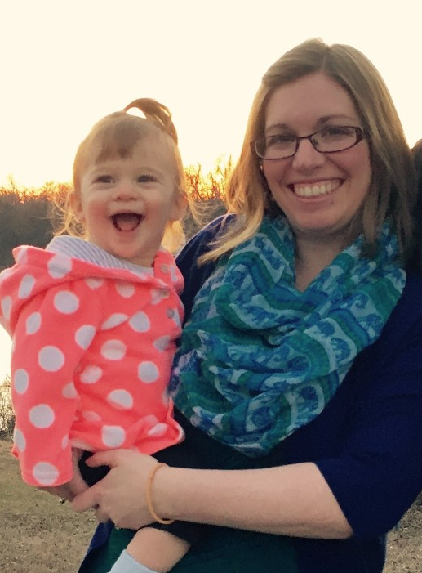
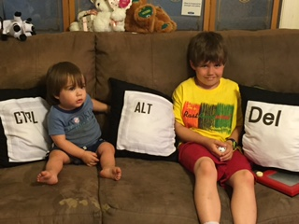
Sponsors (AKA supervisors)
Mrs. Vickers
E-08
Mrs. Hooker A-21

Slide 4
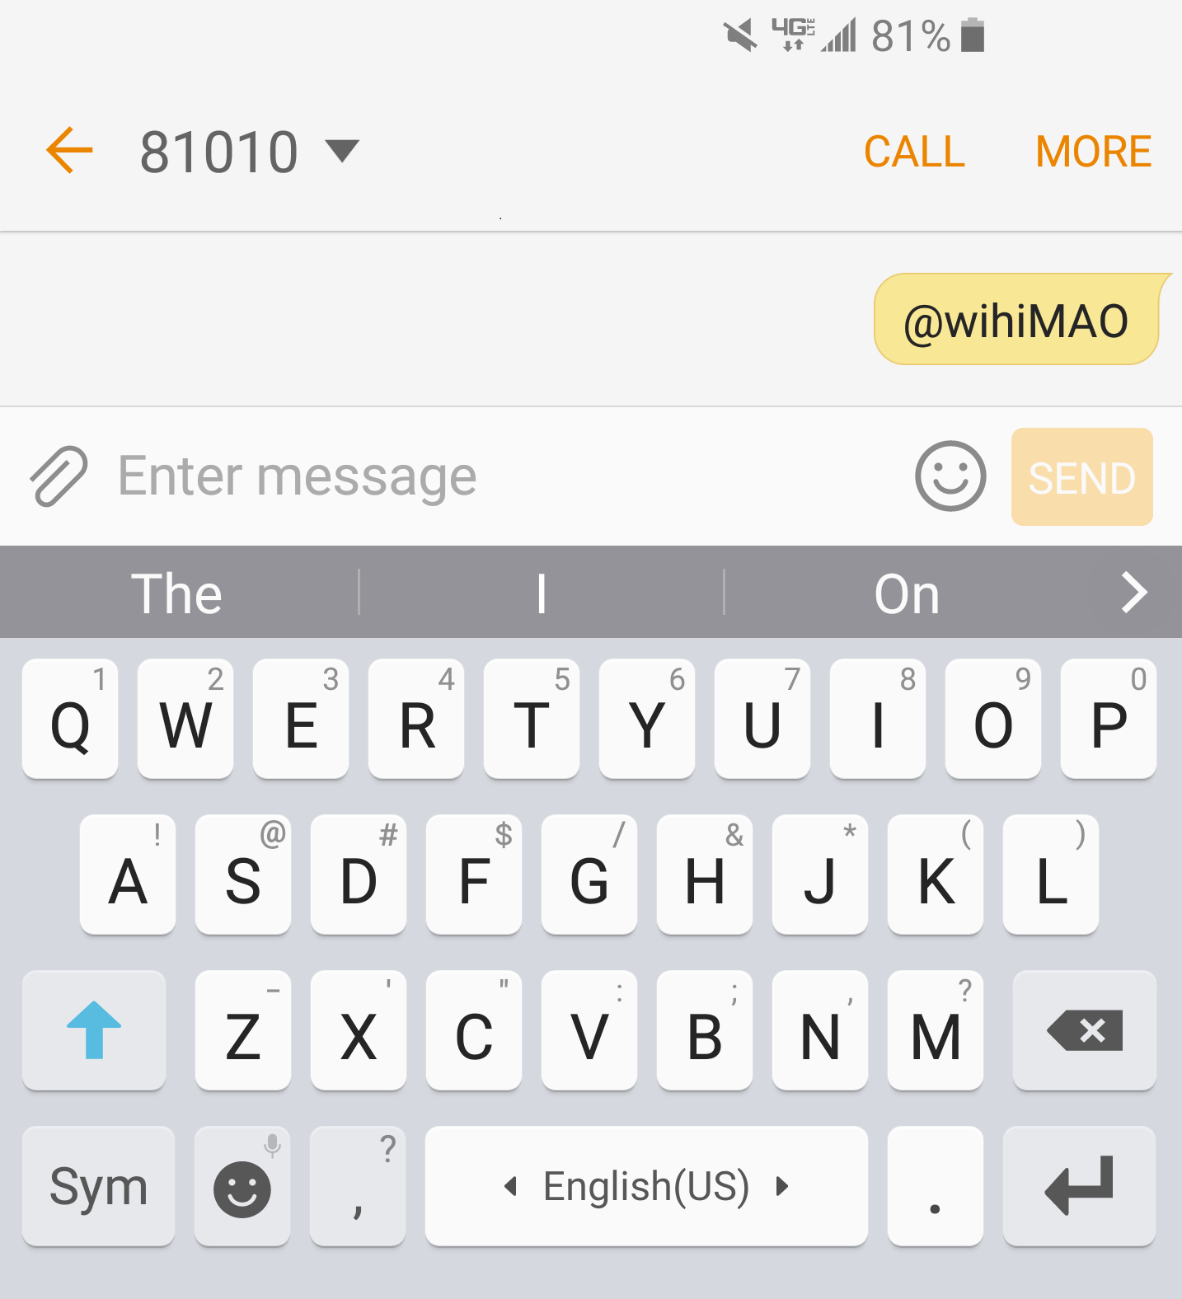
Remind 101
To the number 81010,
Text “@WiHiMAO” (can be all low cap) ** Standard messaging fees may apply

Slide 5
Application
Teacher Recommendations
Two; one from math
Confidential
Due by next meeting
Must be promptly submitted!
New copies available from
Mrs. Vickers (E. 08)
Mrs. Hooker (A. 21)
Guidance
GPA
math courses taken/taking
signature

Slide 6
What is Mu Alpha Theta?
Founded in 1957, MAΘ is a national mathematics honors organization in which the students can share, express, and promote their passion for math as well as to encourage understanding and advancement into higher studies of mathematics.
When are the meeting dates?
Remind101
Calendar

Slide 7
Requirements to Join
GPA
(on unweighted 4.0 scale)
Overall: > 2.0
In Math: > 3.0
No referrals or other bad records
Attend the induction ceremony
Submit the completed application on time
One-time payment of membership fee
Take ≥ 1 math class in each high school year
Be aware of responsibilities & duties

Slide 8
Member Responsibilities
Regularly attend and be present throughout the meetings
1 hour of service each month
Represent MAΘ as an honorary member
Maintain GPA requirement (3.0 in math, 2.0 overall)

Slide 9
Service
Tutoring
After school
Participating in MAΘ-sponsored activities
Other community-service activities

Slide 10
Questions?

